Slide 1




Deep Learning for Fruit Classification By
25-07-2020
code.warriors.help@gmail.com
codewarriors2020

Slide 2
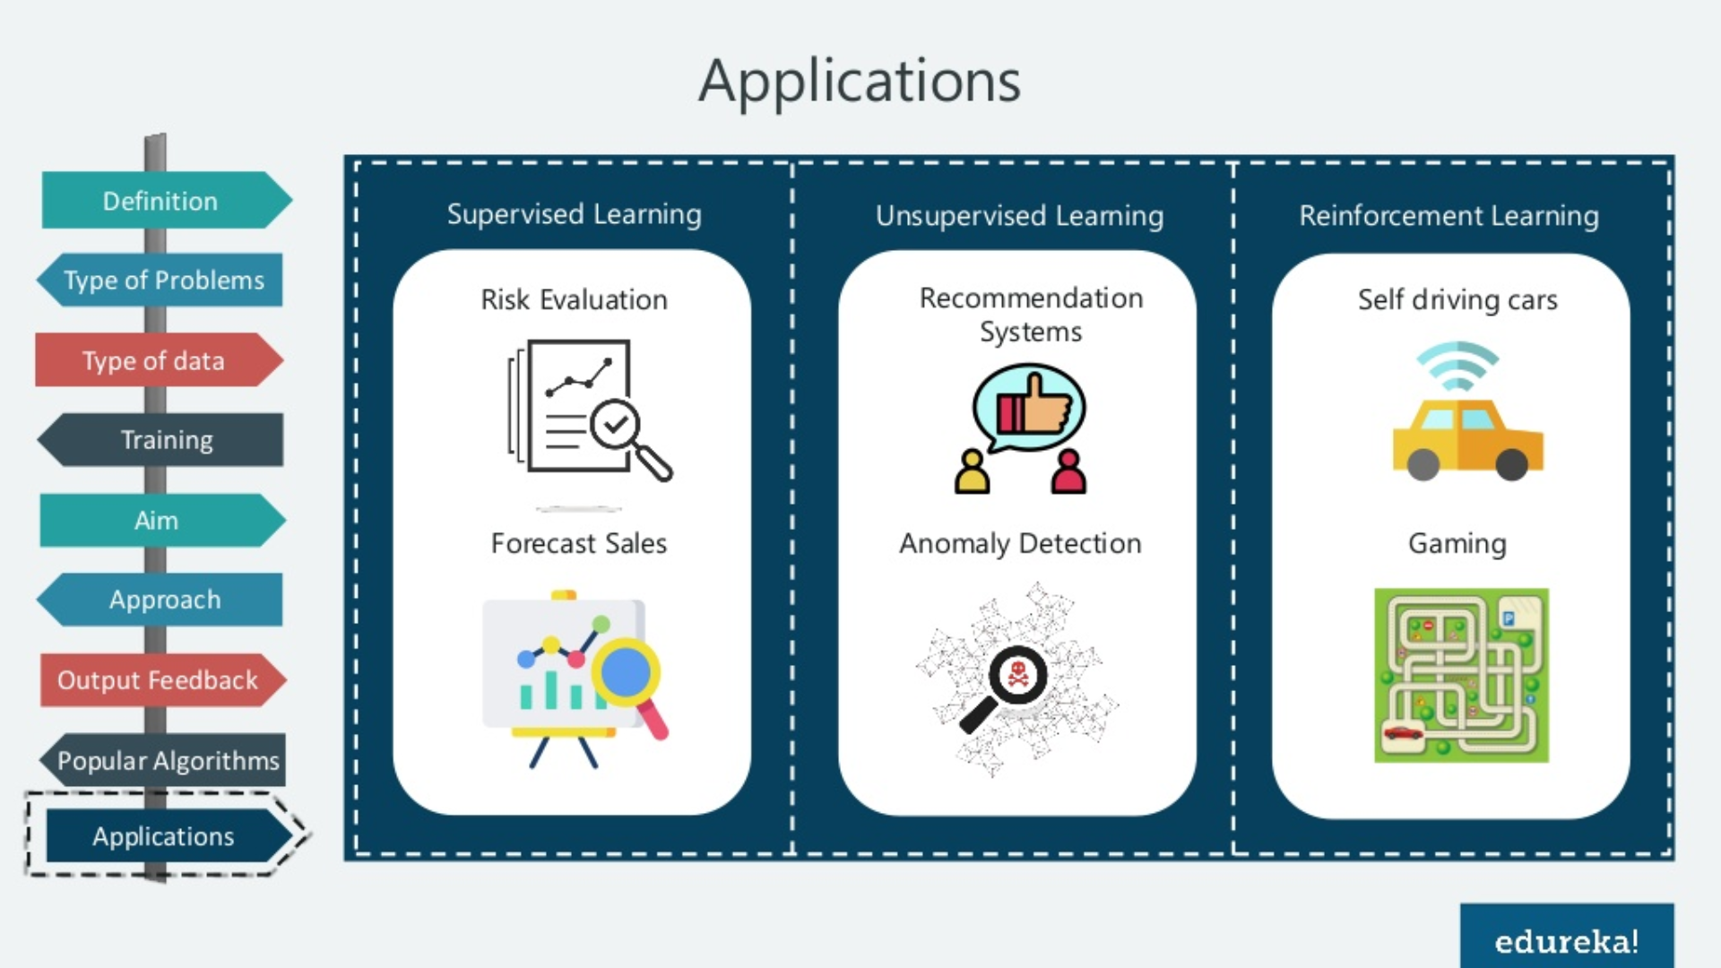
Agenda
What is CNN
Steps for Building CNN Model
Convolution Layer
Pooling Layer
Flattening
Full Connection
Flask Implentation

Slide 3
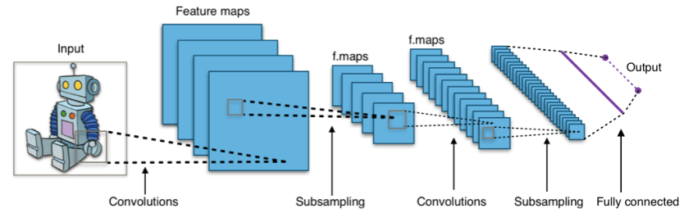
What is Convolution Neural Network (CNN)
CNN is a type of neural network model which allows us to extract higher representations for the image content. Unlike the classical image recognition where you define the image features yourself, CNN takes the image’s raw pixel data, trains the model, then extracts the features automatically for better classification.

Slide 4
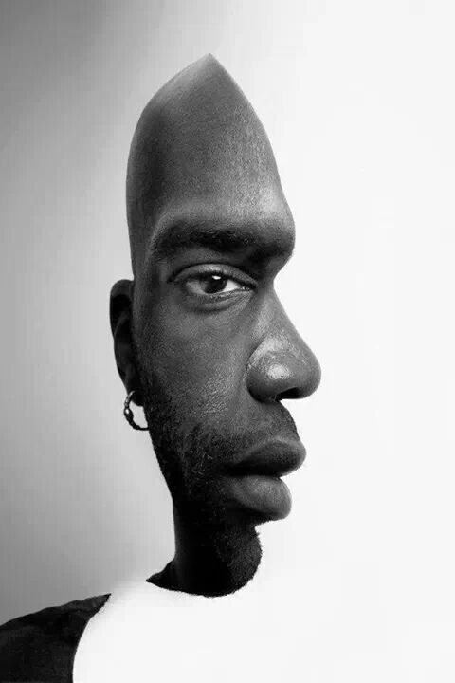
Feature Extraction:

Slide 5

Continue:

Slide 6
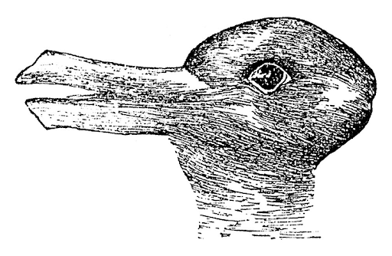
Continue:

Slide 7
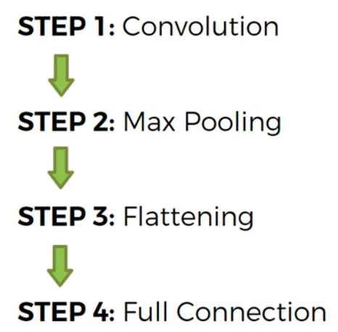
Steps for Building CNN Model:

Slide 8
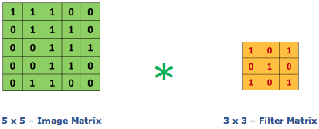
Convolution Layer:
Convolution is the first layer to extract features from an input image. Convolution preserves the relationship between pixels by learning image features using small squares of input data. It is a mathematical operation that takes two inputs such as image matrix and a filter or kernel.

Slide 9
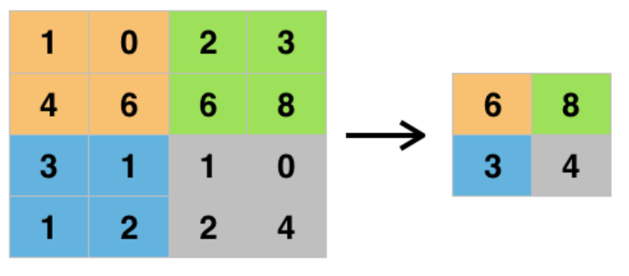
Pooling Layer:
Pooling layers are another way to reduce the size of the image interpretation in order to speed up computation, and it makes the detected features more robust. It’s allows you to determine features that produce the highest impact and reduces the risk of overfitting.
Max Pooling
Feature Map

Slide 10
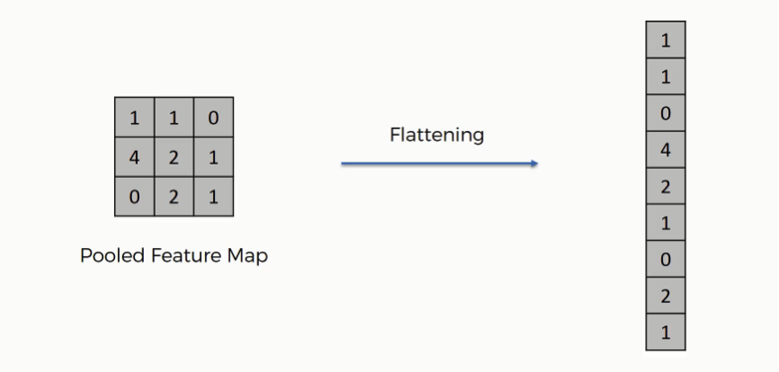
Flattening:
As the name of this step implies, we are literally going to flatten our pooled feature map into a column like in the image below. The reason we do this is that we're going to need to insert this data into an artificial neural network

Slide 11
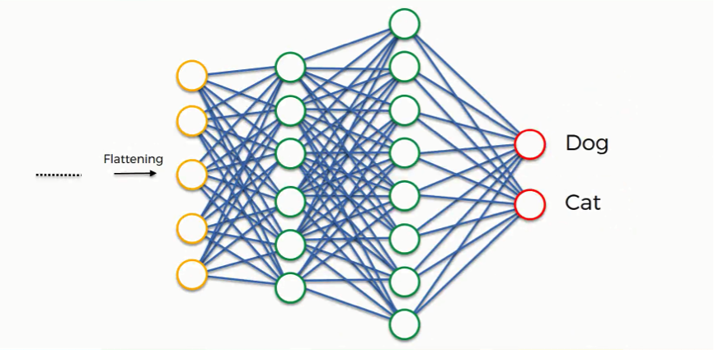
Full Connection:
Fully connected layer involves weights, biases, and neurons. It connects neurons in one layer to neurons in another layer. It is used to classify images between different category by training.

Slide 12

Full CNN Model

